Slide 1
Does Climate Change Have an Impact On Commercial Fishing

Slide 2
Problem: Has climate change had an impact on Comeercial Fishing?
Null Hypothesis: There is no significance statistically in commercial fishing data due to climate change.
Alternative Hypothesis: There is a statistical significance in commercial fishing data due to climate change.

Slide 3
Target Audience
Government Agencies: Local, State and Federal
Academic institutions studying climate control
Commerical Fisherman and Fishing companies

Slide 4
Data Sources and Information
All data was collected from The NOAA.gov website
Data included seven fish species and five major measurements, mean weight, abundance, biomass, total number caught and ratio of total number caught per station.
The area of focus was the Bering Sea region in Alaska.

Slide 5
Data Analysis
Data was collected from 2000 to 2017
The data collected was groupby the year and species then merged using year.
Data was then visually displayed.
Spearman Correlation Coefficient was used to compare our different measurements.
An evaluation was then made to determine if there is evidence to support or reject our null hypothesis.

Slide 6



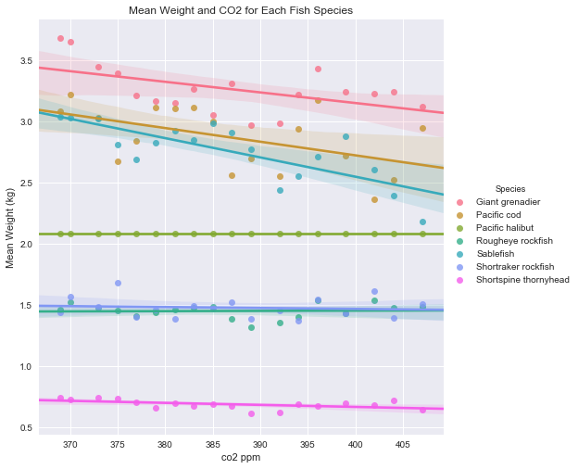
Comparing Mean Weight and the levels of CO2 for Each Fish Species
Great Grenadier, Pacific Cod and Sablefish showed a negative correlation.
Other species showed a flat or no correlation
We would expect to see a negative correlation if Climate change was impacting the Mean Weight
Spearman value= -0.08

Slide 7
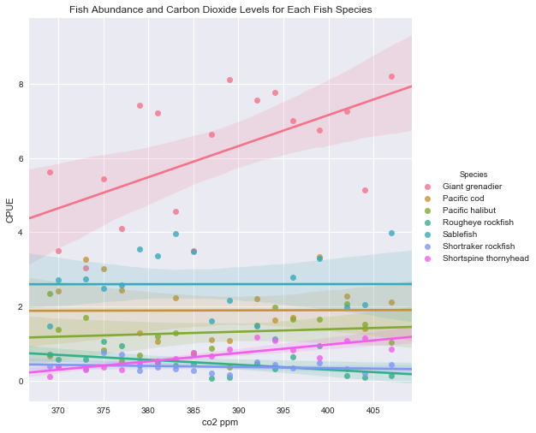
Abundance of fish related to CO2 for each fish species
Most Fish Species show little or no correlation with the Giant Grenadier having a positive correlation
Again, we would expect a negative correlation if in fact climate change was having an impact on the fish population
Spearman value= 0.04

Slide 8
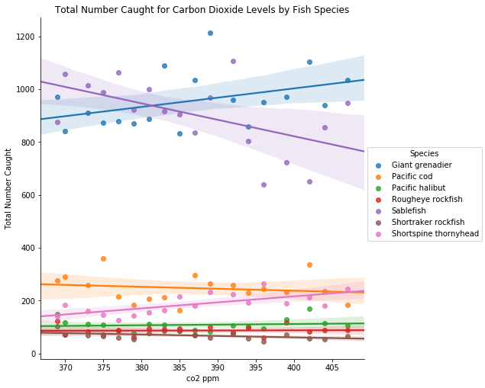
Total Number Caught for each species compared to CO2 levels
The total number caught related to CO2 shows mostly a flat or zero correlation with the Great Grenadier showing a positive correlation and sablefish showing a negative correlation
Spearman value= 0.001

Slide 9
Learning Model
Chose logistic regression supervised learning model
Predict the species of fish using our top 3 metrics
Placing data into a test set and a training set
Calculate the success rate of the model

Slide 10
Logistical Regression
Used sklearn along with python to build a supervised learning model.
Used sklearn and imported preprocessing in order to standardize all of the data
After standardization of our column data, RFE was imported from sklearn in order to narrow our column data down to the top 4 ranked columns.
Imported GridSearchCV to calculate the best C value for the Logistic Regression model
Used Logistic Regression to predict the fish species using the top three RFE columns

Slide 11
Model Analysis
According to RFE, the 4 best columns to make a prediction are: CPUE, Total Number Caught, Mean Weight(kg), and CO2 (ppm).
Using GridSearchCV, our best value for C is 10.0 with an 83 %.
Passing all of this information into our LogesticRegression model, a 94.5% success rate was observed

Slide 12
Thoughts On Making the Model Better
Use the number of predators of each fish and how predators can impact fish populations.
Find the temperature and pH values for the given area and use those along with CO2 levels.
Determine the number of fishing vessels each year and use that information to determine if an area is fished more.
After building the model, there are a few things we could do to enhance and improve the models performance.

Slide 13
Conclusion
According to our data and graphs, we cannot rule out the Null Hypothesis. The spearman values indicate little to no correlation for any of the column data when compared to CO2. There are however some of the species that exhibited the kind of numbers that would be expected if there was some influence due to carbon dioxide especially when examining the fish species mean weight. The rest of the values showed no correlation of any significance so once again our Null Hypothesis cannot be rejected.

